Slide 1
If you build a random forest, they will come
Photo: Charlie Neibergall, Associated Press

Slide 2
INTRODUCTION TO THE HALL OF FAME
The National Baseball Hall of Fame was established in 1936
Since 1966 (and most years before that), 400+ members of the Baseball Writers’ Association of America (BBWAA) have had the annual responsibility of voting players into the Hall of Fame
The threshold for election is 75% of the vote
The 2019 BBWAA inductees will be announced on January 22nd
Traditional or Advanced Statistics?

Slide 3
PROJECT GOAL/FIELDING THE DATA
Project goal: To build a model based exclusively on traditional baseball statistics that does a better job of predicting Hall of Fame election by the BBWAA than a similar one built using only advanced statistics.
What the project does not attempt: To build the best possible model for predicting Hall of Fame election.
Retrieving the data: I compiled a list of everyone who has appeared on a BBWAA Hall of Fame ballot since 1966 (using Sean Lahman’s Baseball Database), linked them to their statistics (pulled from BaseballReference.com), separated them into hitters and pitchers (excluding relievers), and coding their election status as 0 and 1.

Slide 4
PLAN OF ACTION
1. Select classification model types for the hitter/pitcher datasets
2. Use cross-validated grid search to tune models built exclusively around traditional statistics to produce the most accurate predictions of Hall of Fame election by the BBWAA
3. Use cross-validated grid search to build and tune models of the same classification types around advanced metrics, and see how their predictive accuracy compares to the above models
4. Use the superior models to predict future Hall of Fame electees

Slide 5
TRADITIONAL AND ADVANCED STATISTICS
Examples of traditional statistics:
Hitters: Hits, Homeruns, Batting Average, On-Base Plus Slugging (OPS)
Pitchers: Wins, Strikeouts, Complete Games, Earned Run Average (ERA)
Advanced statistics:
WAR (Wins Above Replacement)- aggregate statistic used to determine the number of wins a player is worth over a replacement-level player
WAR7- best 7 years of WAR, or “peak WAR”
JAWS- average of WAR and WAR7, developed by statistician Jay Jaffe
OPS+ (hitters)/ERA+ (pitchers)- OPS and ERA scaled against the league average

Slide 6
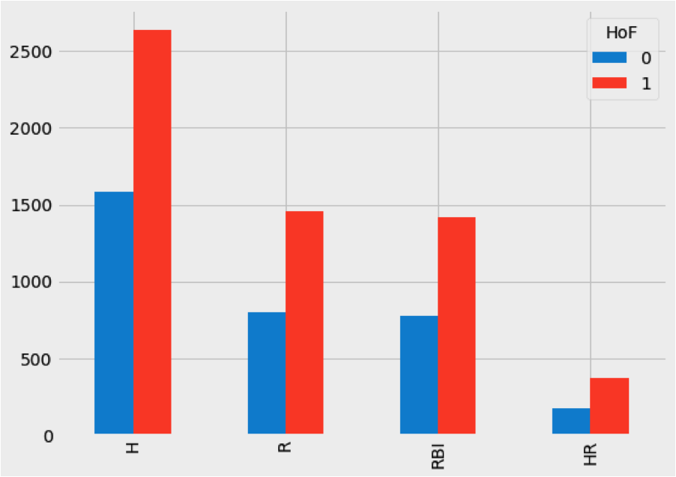
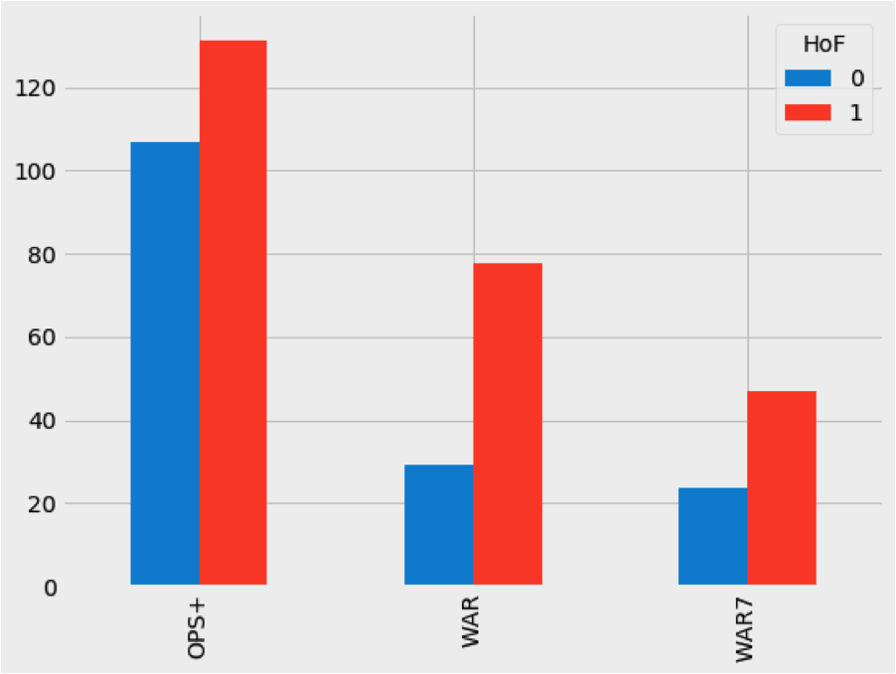
Hall of famers vs. non-hall of famers

Slide 7
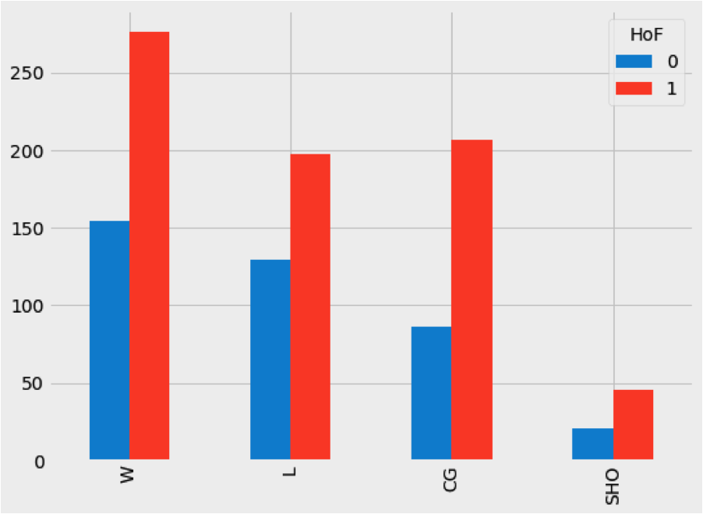
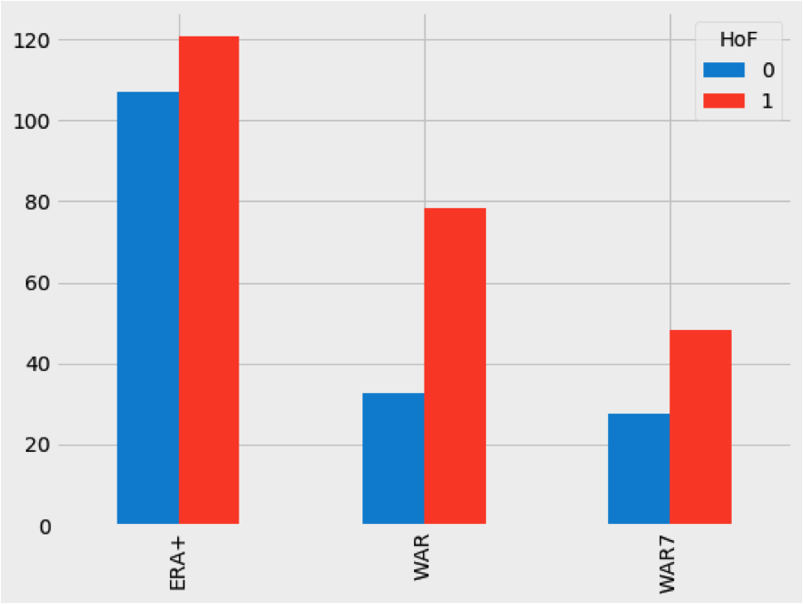
Hall of famers vs. non-hall of famers

Slide 8
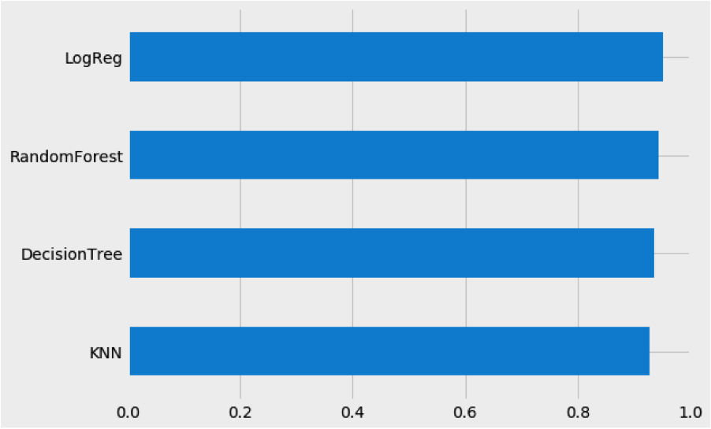
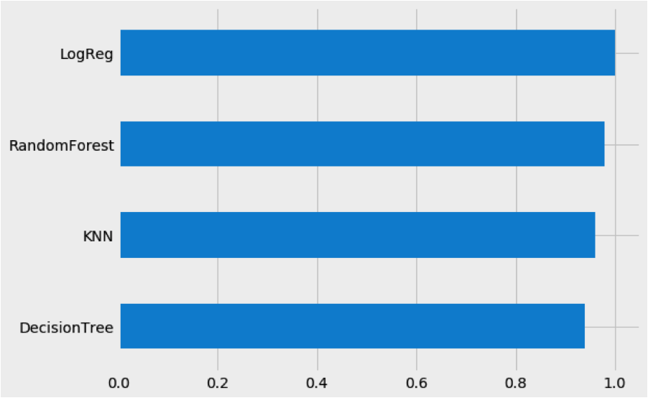
Model selection
Hitters
pitchers

Slide 9
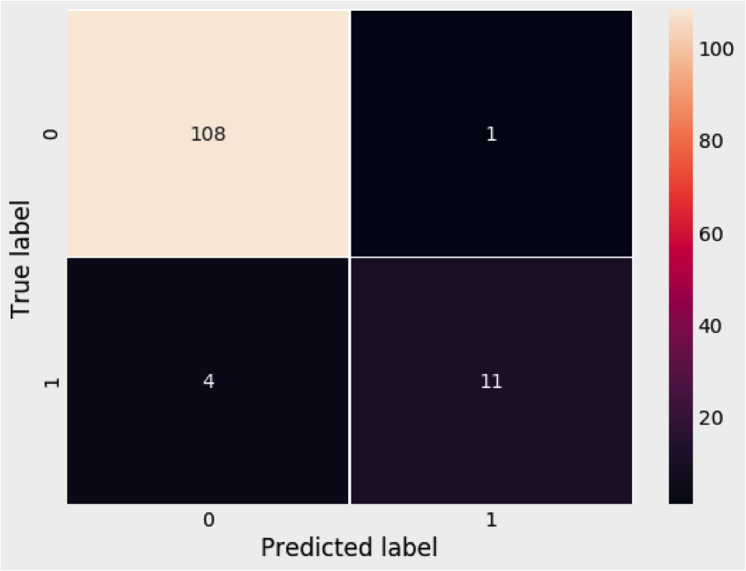
Traditional Hitting model
Model: RandomForestClassifier(n_estimators=9, max_depth=6,max_features=4, random_state=1)
Best CV Score: 0.956989247311828
Testing Accuracy: 0.9596774193548387 (8% better than null baseline)
Top 4 Feature Importance: Hits, Runs, All-Star Games, Runs Batted In

Slide 10
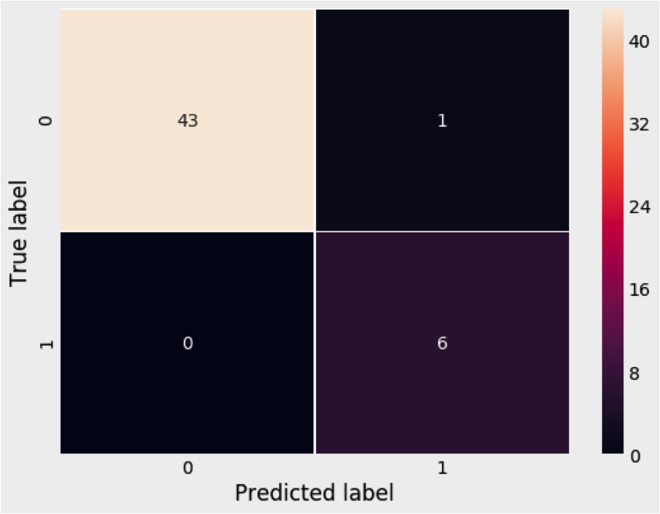
Traditional pitching model
Model: RandomForestClassifier(n_estimators=5, max_depth=5,max_features=4, random_state=1)
Best CV Score: 0.972972972972973
Testing Accuracy: 0.98 (10% better than null baseline)
Top 4 Feature Importance: All-Star Games, Wins, Shutouts, Winning Percentage

Slide 11
Traditional vs. advanced (hitting)
Traditional
advanced
Best CV Score: 0.956989247311828
Testing Accuracy: 0.9596774193548387
Best CV Score: 0.9354838709677419
Testing Accuracy: 0.9435483870967742
(Model built with max_depth=1, n_estimators=10)

Slide 12
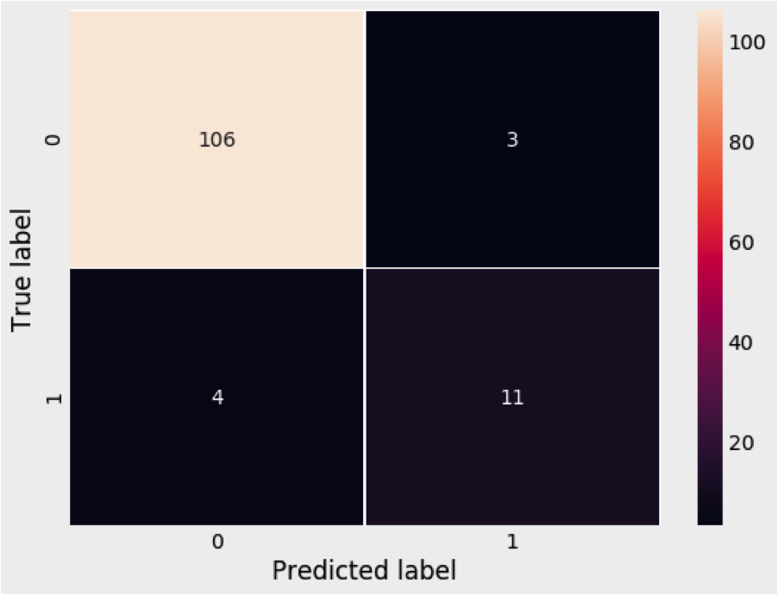
Traditional vs. advanced (hitting)
tRADITIONAL
ADVANCED

Slide 13
Traditional vs. advanced (pitching)
TRADITIONAL
ADVANCED
Best CV Score: 0.972972972972973
Testing Accuracy: 0.98
Best CV Score: 0.9662162162162162
Testing Accuracy: 0.9
(Model built with max_depth=6, n_estimators=6)

Slide 14
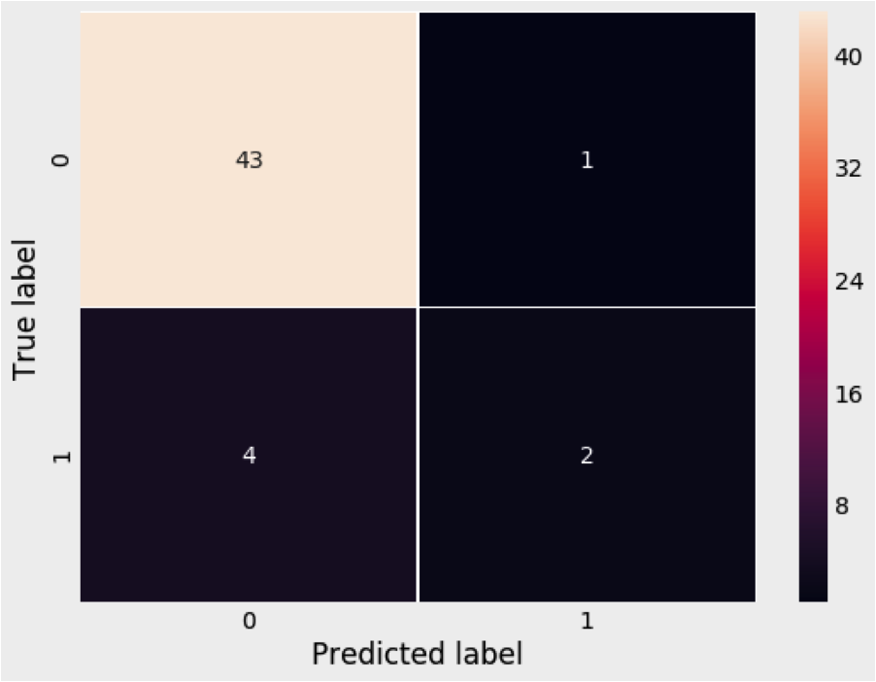
Traditional vs. advanced (pitching)
TRADITIONAL
ADVANCED

Slide 15
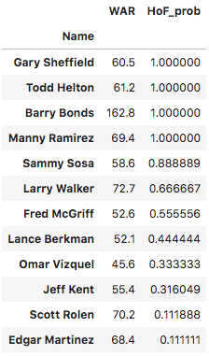
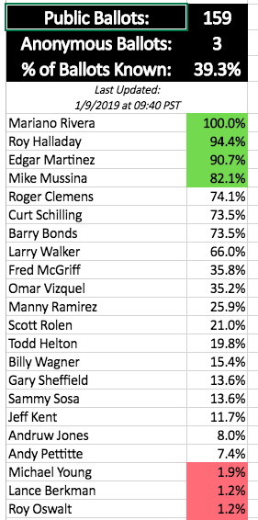
Predicting hall of fame hitters (2019 ballot)
2019 Ballot Hitters
Ryan Thibodaux’s hall of fame vote tracker

Slide 16
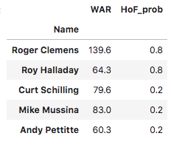
Predicting hall of fame pitchers (2019 ballot)
2019 Ballot pitchers
Ryan Thibodaux’s hall of fame vote tracker

Slide 17
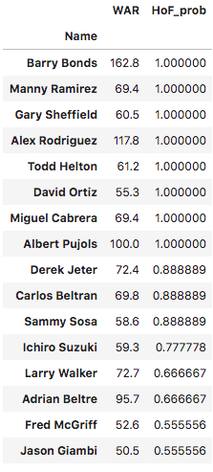
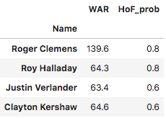
Predicting future hall of famers
eligible hitters (over 50%)
eligible pitchers (over 50%)

Slide 18
LIMITATIONS/CONCLUSION
1. The BBWAA isn’t one singular immortal voting body, so predicting how they will vote is an inexact science
2. Many influencing factors outside of statistics, including: steroid use, markets played in, media interaction
3. Many Hall of Fame voting rules changed before and after 1966
4. Random Forests for traditional models, though limited to max_features=4, were allowed to choose any four from the bunch, while there were only four advanced metrics to choose from
Conclusion: The traditionally-based Random Forest models built here serve as strong predictors of Hall of Fame induction by the BBWAA

Slide 19
nEXT STEPS
1. Position-by-position analysis
2. Building the best possible predictive model of Hall of Fame induction

